Slide 1
Grammatical classes of words

Slide 2
Plan:
Notional and functional parts of speech.
Sub categorization of parts of speech.
Syntactic classification of word stock.

Slide 3
Parts of speech
Notional
Functional

Slide 4
Noun

Slide 5
Proper
John, London, John Wesley, Queen Mary, January, February, Thanksgiving
Common
girl, person, city, river, lake

Slide 6
Animate
man, scholar, butterfly, leopard, etc.
Inanimate
earth, field, machine, book, etc.

Slide 7
Countable
Uncountable

Slide 8
Concrete
flower, bird, book, sand, star, butterfly, cloud etc.
Abstract
Feelings such as happiness, loneliness, sorrow and anger
Qualities such as courage, intelligence, bravery and honesty
Ideas and thoughts such as freedom, friendship and equality

Slide 9
Verb

Slide 10
Fully predicative
walk, sail, prepare, shine, blow
Partially predicative
can, may, shall, be, become

Slide 11
Transitive
take, put, speak, listen, see, give
Intransitive
live, float, stay, ache, ripen, rain

Slide 12
Action verbs
write, play, strike, boil, receive, ride
Stative verbs
know, believe, see, hear, smell love, like, hate

Slide 16
PRONOUN
Personal
Possessive
Reflexive
Reciprocal
Relative
Demonstrative
Interrogative
Indefinite

Slide 17
Personal Pronouns
They went to the store.
He runs a great shop in town.
Possessive Pronouns
Is that my book?
No,that's his book.
Reflexive Pronouns
They bought themselves a new car.
Relative Pronouns
A person who loves nature is a good person.

Slide 18
Demonstrative pronouns
I prefer this.
Did you see that?
Interrogative Pronouns
What was the name of your dog?
Which is your favorite movie?
Indefinite pronouns
Everyone is here already.
Reciprocal pronouns
The boxers punched each other.
The couple love one another deeply.

Slide 19
Numeral
Ordinal
Cardinal

Slide 20
Cardinal numerals
She has got three brothers.
He wrote 130 essays, 52 stories, and 7 novels.
Ordinal numerals
The first story was interesting. The second was dull.
John Kennedy was the 35th president of the United States.

Slide 21
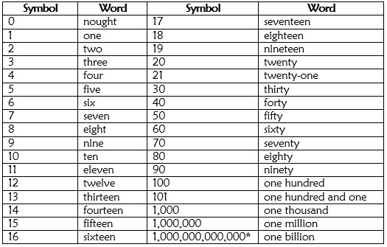
Cardinal numerals

Slide 22
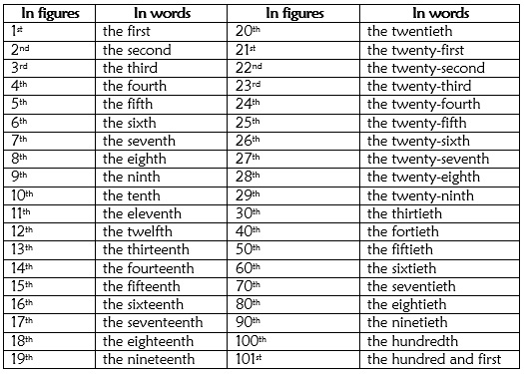
Ordinal numerals

Slide 23
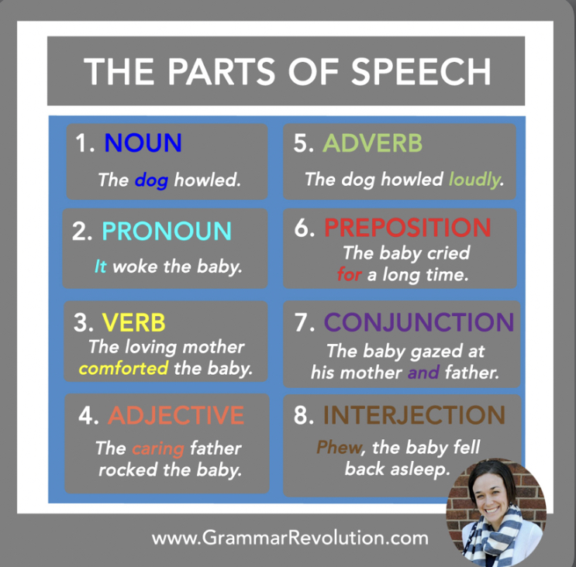

Slide 24
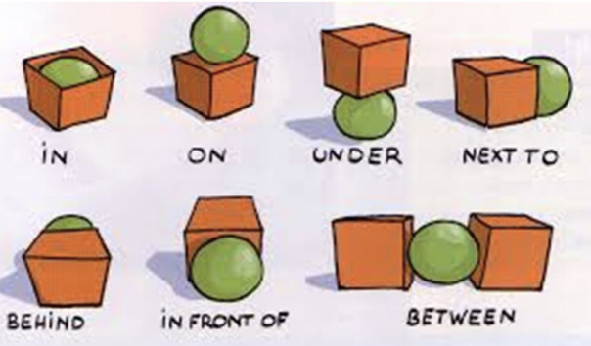

Slide 28
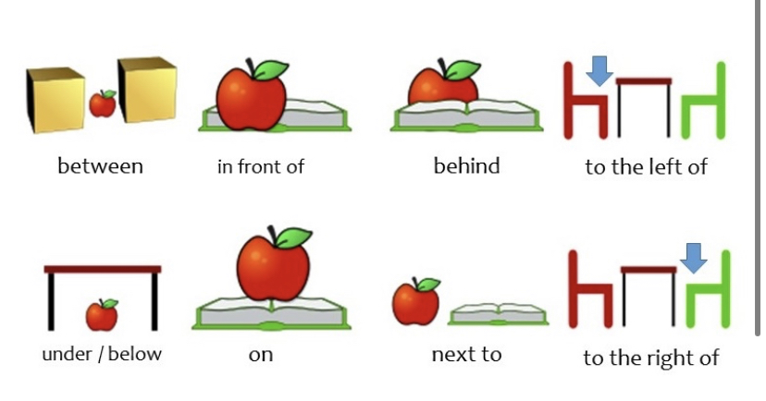

Slide 29
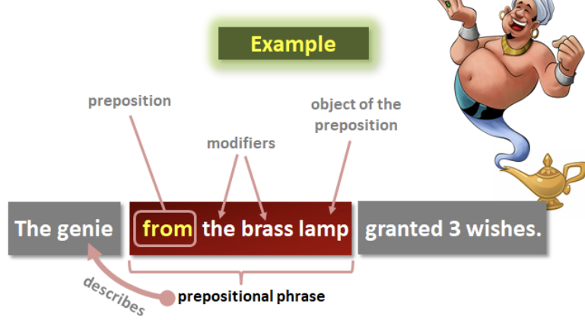

Slide 30
Particle
Form-generative
Would, and, let
Negative
(do)not, nor
Modal

Slide 31
Interrogative
If, really, is; really
Indicative
Here you are, there
Specifying
Do, also
Exactly, just, directly, exactly the same
Restrictive
What a, what
Only, exclusively, nearly
Exclamation
Amplifying
Even, again, after all, indeed, all the same
Mitigation of the requirements
Doubt
Let it, let`s
Hardly
Incentive

Slide 32
Interjection
Ah!
Oops!
yes
Hah!
Phew!
Ugh
Hey
eh

Slide 33
Onomatopoeic and addressing words:
chick-chuck-chicken
pur-pur-pur
clank-clank-clank

Slide 34
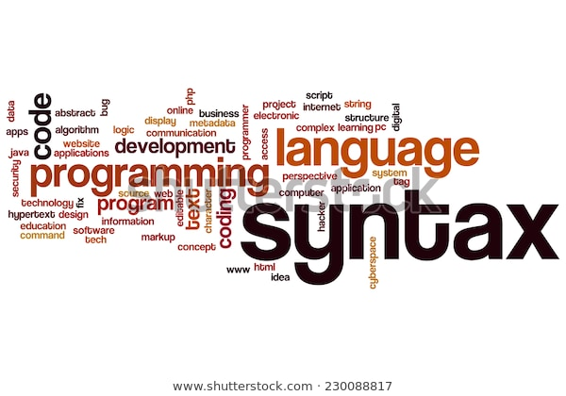
The syntactic classification of word stock
The syntactic classification of words is based on syntactic featuring of words. The syntactic classification of words, in principle, supplements the three-criteria classification spec­ifying the syntactic features of parts of speech.

Slide 35
Three-criteria classification
Three principles
Meaning
The meaning common
to all the words
of the given class.
Form
The morphological
characteristics of
a type of word.
Function
The syntactical
properties of a
typo of word.

Slide 36
Syntactic classification
of words
Based on syntactico-
distributional
criterion
Based on
function

Slide 37
Thank you for attention!!

